Slide 1
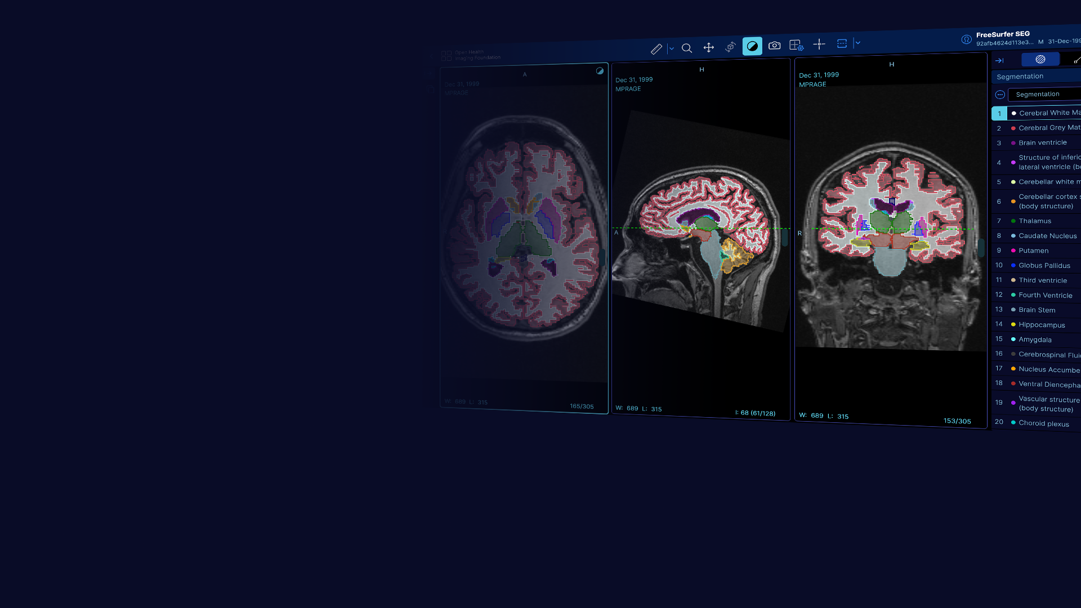
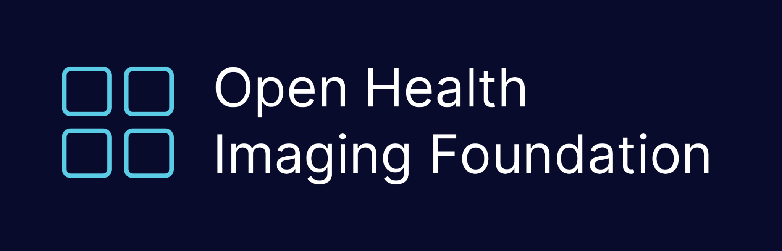


Advisory Board Meeting
May 13th, 2026

Slide 2
Funding Update
ITCR Year 4
Year 4 began May 1
0.8 FTE developer and 0.25 QA tester
Set-aside project with FU Berlin: ~ 4 months 1 FTE total
R03 Year 1
0.5 FTE developer primarily focused on increasing test coverage
Other aims: FHIRcast extension, dcmjs and dicom-parser modernization
Potential Funding
ITCR supplement proposal submitted
Scope: expand OHIF interoperability via web-API interface with 3D Slicer web server

Slide 3
Action Based on Advisory Board Feedback Feb. 2026
Extensibility
Recommended: Meet with 3D Slicer team to review extension model
Result: OHIF and 3D Slicer worked closely together and submitted a new joint funding proposal to broaden interoperability between the platforms
Community Feedback
Recommended: Draft community survey
Result: Community usage survey created. Scope of feedback will be expanded following recommendations from this meeting
Contributor Workflow
Recommended: Define lightweight pre-PR design review process
Result: OHIF has dedicated more staff time to PR review and implemented automation in the review process
Breaking Changes
Recommended: Document and announce breaking changes further in advance
Result: OHIF is releasing latest Cornerstone breaking changes to a beta branch first

Slide 4
OHIF 3.13 - Expected Release Late May/Early June
Major Changes
Updated Cornerstone to 5.x (beta)
Performed audit of segmentation tool suite:
Overhauled one-click segmentation tool
Bug fixes and optimization
Smart scrollbar
Enhanced crosshairs
Viewport UI improvements
Updated worklist to new UI components. All of OHIF is now on UI-next
Created theming guide to assist with new component adoption
Calibration and measurement tool suite fixes
Currently in testing and refinement phase.

Slide 5
Discussion: Sustainability in Open Source
We are seeing a decline in community engagement without a decline in usage metrics, which we attribute to overall AI coding trends
Thoughts about how OHIF and open source in general should navigate this changing landscape?
What have been the biggest changes in your experience?
What can we do to support the new dynamic of community members copying the repo and letting AI build on top of it?
What do you want to see OHIF prioritizing to provide more value to the community now?
Initial thoughts:
A team of experts is still valuable to support the core and facilitate use of the repos
If your teams have experiences related to this, please share!

